Slide 1
Web Science
Military KG Construction
Group：1
Date：12/24/2019
Lee
Alvin
Sam
Mircale

Slide 2
01
01
Introduction
02
02
Skeleton
03
03
Procedure
04
04
Application
05
05
Conclusion
06
05
Reference

Slide 3

Introduction

Slide 4
Background
With the explosive growth of battlefield information, traditional search engines and query methods have been unable to meet the needs of battlefield information and a large number of military knowledge acquisition and understanding.
Knowledge graph technology has shown great advantages in solving the accuracy and scalability of knowledge query, which has become a hot issue of people's research.
The knowledge graph of military domain, especially the knowledge graph of military domain, is not well constructed and expressed.
Notes:
With the explosive growth of battlefield information, traditional search engines and query methods have been unable to meet the needs of battlefield information and a large number of military knowledge acquisition and understanding.
Knowledge graph technology has shown great advantages in solving the accuracy and scalability of knowledge query, which has become a hot issue of people's research.
Most of the existing knowledge graphs are general knowledge graphs. The knowledge graph of military domain, especially the knowledge graph of military domain, is not well constructed and expressed.
Therefore, it is of great significance to establish the knowledge graph of military domain.

Slide 5
Tasks
Constructing a knowledge graph for a specific domain – Domain: Military – Source data: crawling data from Web (>=2 data sources) – Ontology: knowledge representation, concepts, properties, … – Knowledge graph: • knowledge extraction (entity, relations) • knowledge fusion/integration • knowledge storage • knowledge embedding (optional) – Knowledge graph sizes: • >100,000 entities • >1,000,000 triples Intelligent applications based on the knowledge graph – Semantic search – Question answer – Visualization (optional) – Mining and analyzing knowledge graph (optional)

Slide 6

Skeleton

Slide 7
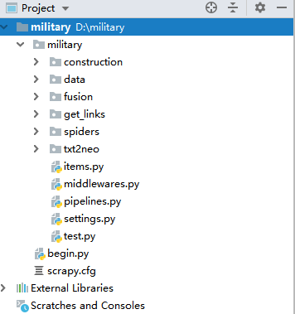
Project Structure
Some Scrapy Files
Six packages

Slide 8
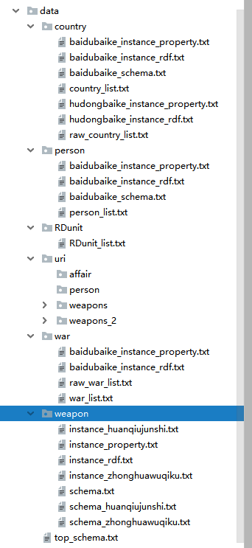
Project Outcome
Through rough statistics, we get 6056 + 6553 + 7324 + 88622 + 110 = 108665 triples.
About 5810 + 1718 + 872 + 227 = 8627 entities are created.

Slide 9

Procedure

Slide 10
Domain Definition
Domain definition is an important beginning of the whole project. Because the knowledge graph to be created is military, we define our domain as military.
Strating from military, we expand and identify some specific sub-field including weapon, person, country, R&D unit and war.

Slide 11



Data Source Selection

Slide 12
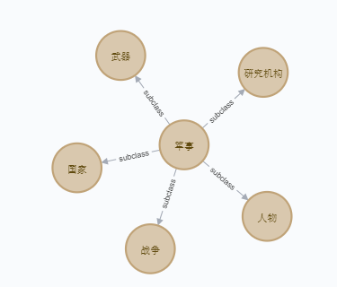
Ontology Construction
Top-Concept layer

Slide 13
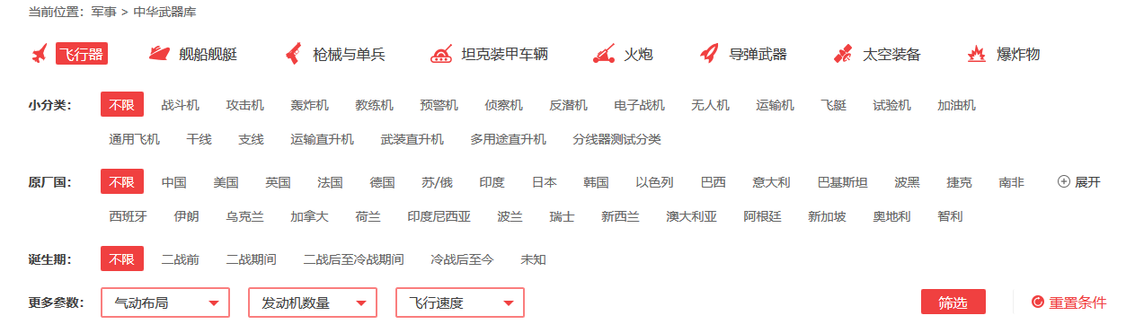
Ontology Construction
Sub-Concept layer

Slide 14
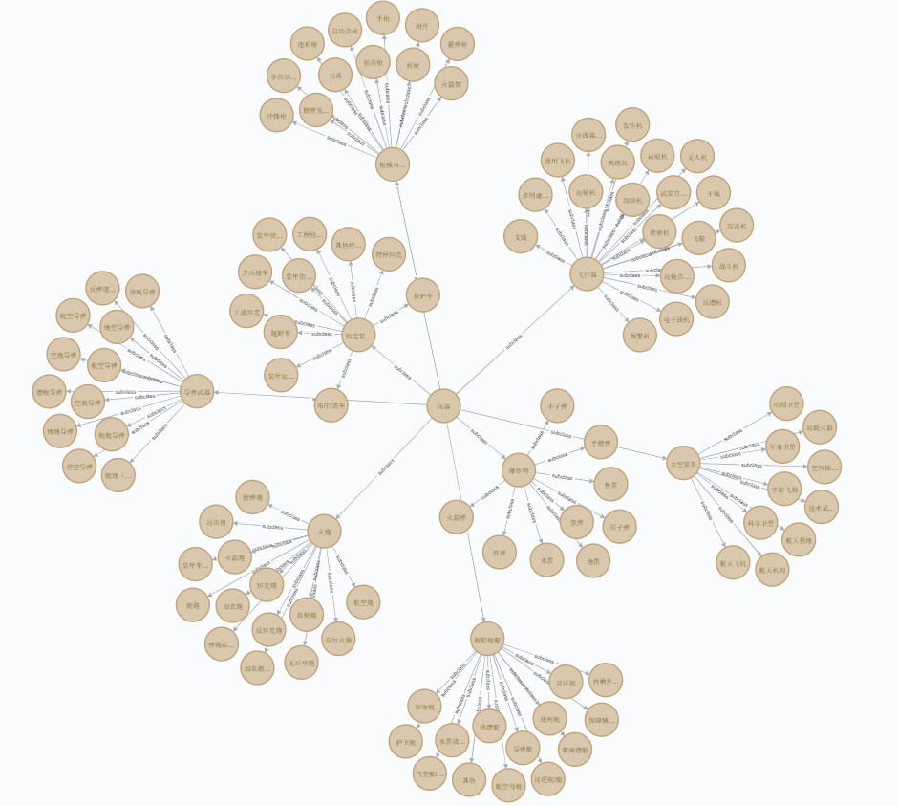
Ontology Construction
Sub-Concept layer

Slide 15
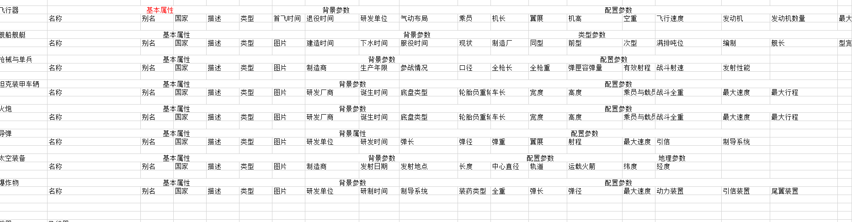
Ontology Construction
Instance layer
select more than ten instance which belong to the same bottom concept and intersect their properties as the final ontology of this kind of instance.

Slide 16
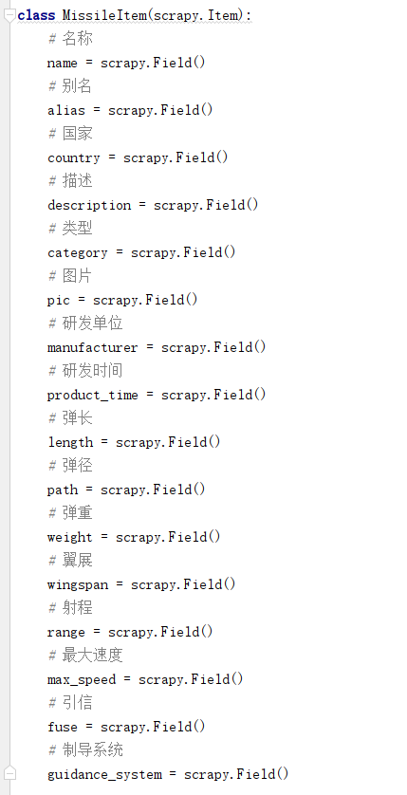
Data collection and knowledge extraction
Schema
Item Structure
Extract Template

Slide 17
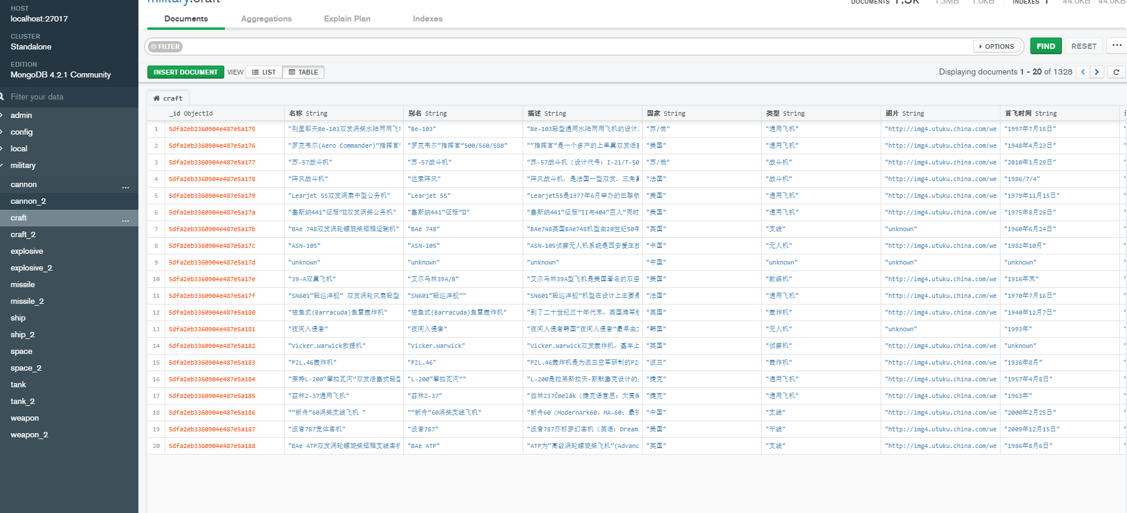
Data collection and knowledge extraction

Slide 18
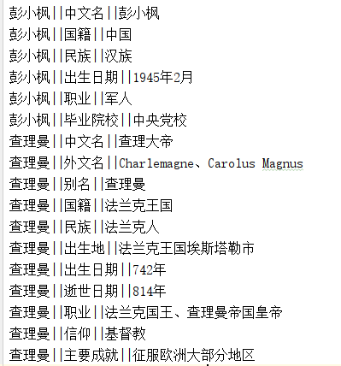
Knowledge Fusion
Two format
RDF
Dictionary

Slide 19
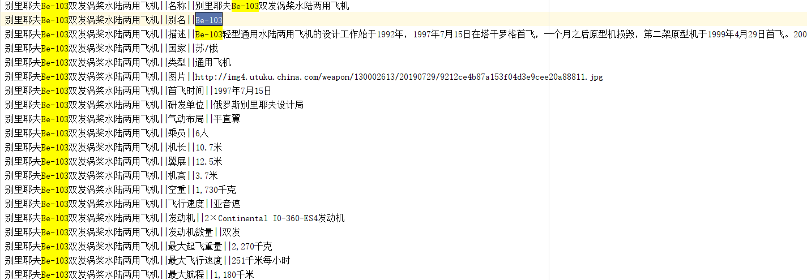
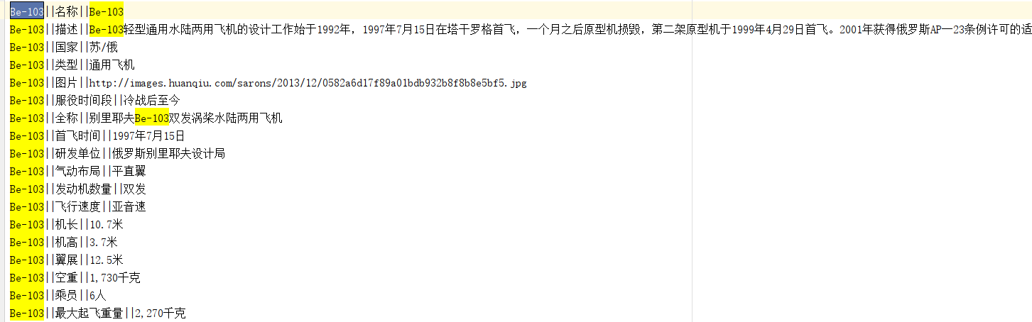
Knowledge Fusion

Slide 20
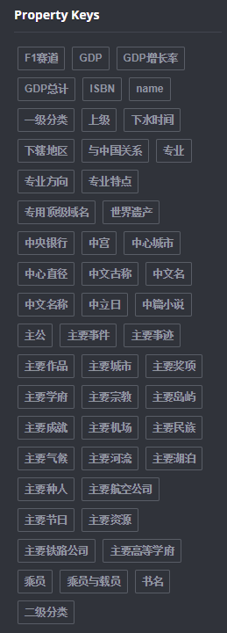
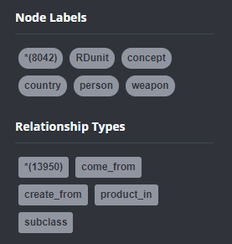
Knowledge Storage
Data components

Slide 21

Application

Slide 22
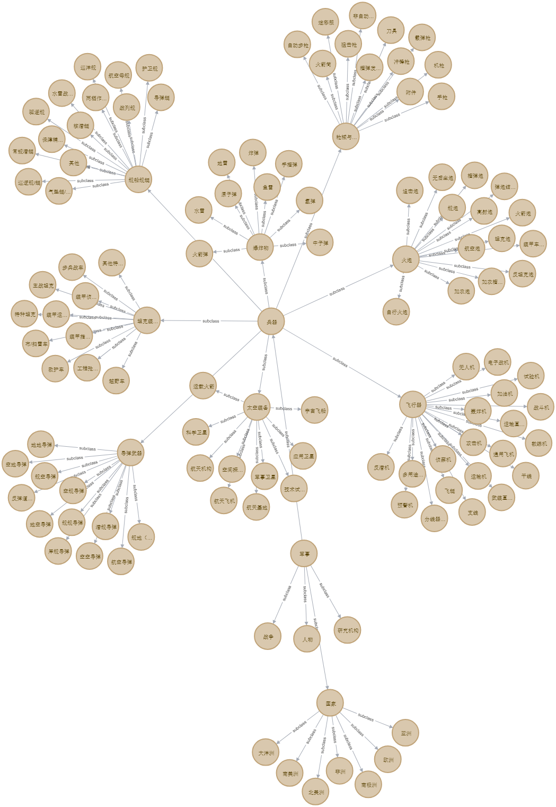
Visualization
Concept Schema Structure

Slide 23
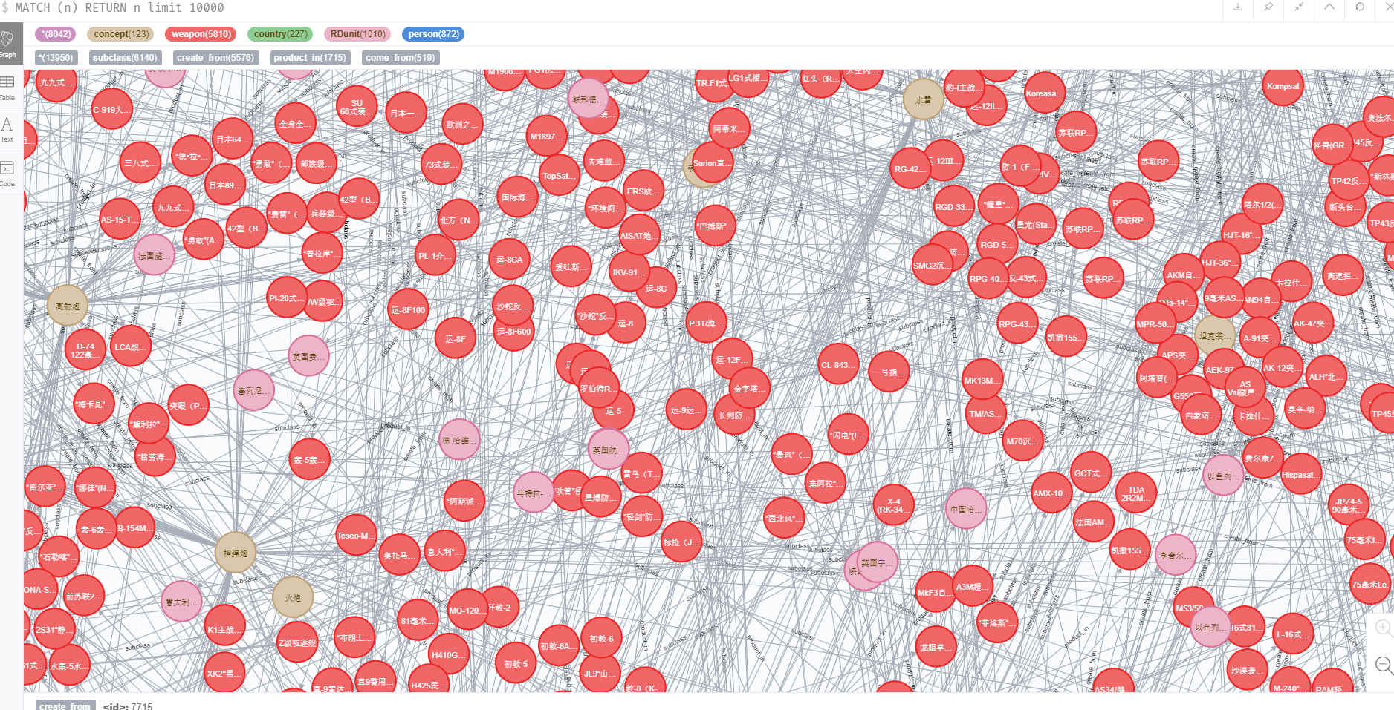
Visualization
All Graph Structure

Slide 24

Conclusion

Slide 25
Achievements
108665 triples
8627 entities
8042 nodes, including 123 concept nodes, 5810 weapon nodes, 227 country nodes, 1010 R&D unit nodes and 872 person nodes
13950 relationships.

Slide 26
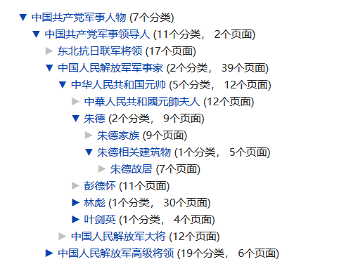
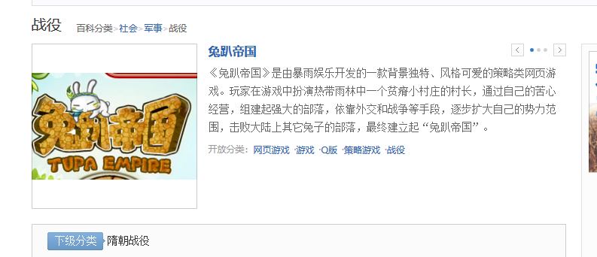
Problems
1. Some category hierarchies can not be used directly to construct schema, which need maunal processing.
Lack detailed information
Error information

Slide 27
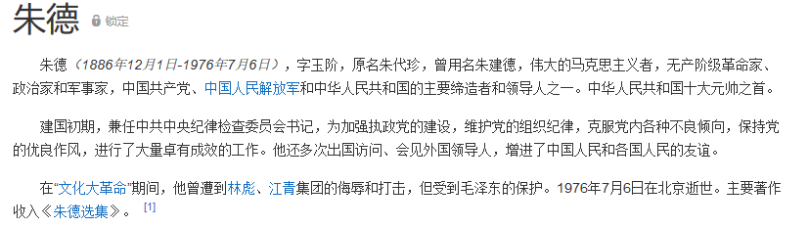
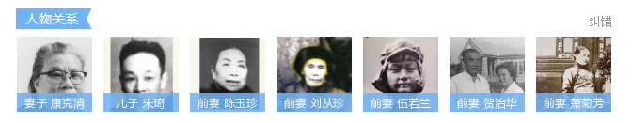
Problems
2. Some information like abstract and so on are wasted because of we have not process them to get data.

Slide 28
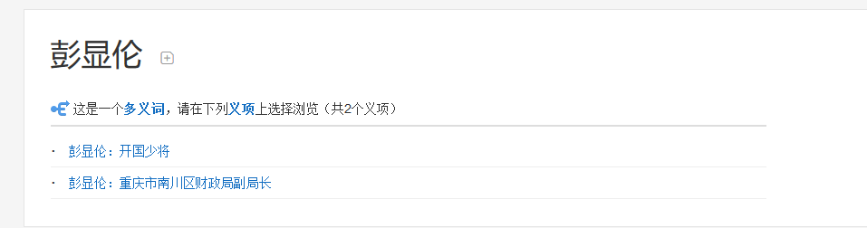
Problems
3. Some words have many synonyms, which need to process.

Slide 29
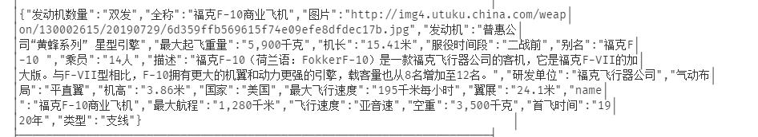
Problems
4. Property values are stored only as string.

Slide 30
Future works
1.Construct complete ontology for all fileds.
2.Get complete data source, especially the source of raw data.
3.Process disambiguation for synonyms.
4.Categorize property values, which can make data more precise.
5.Try to use more methods to process fusion and conflict (not only literal layer)

Slide 31

Reference

Slide 32
Reference
Noy N F, McGuinness D L. Ontology Development 101: A Guide to Creating Your First Ontology
Sören Auer, Bizer, C. , Kobilarov, G. , Lehmann, J. , & Ives, Z. G. . (2007). Dbpedia: a nucleus for a web of open data. Semantic Web.
Wang, H. , Wu, T. , Qi, G. , & Ruan, T. . (2014). On Publishing Chinese Linked Open Schema. International Semantic Web Conference. Springer International Publishing.
Suchanek, F. M. , Kasneci, G. , & Weikum, A. G. . (2008). Yago - a large ontology from wikipedia and wordnet. Web Semantics Science Services & Agents on the World Wide Web, 6(3), 203-217.

Slide 33
Thank you！
Teacher：Peng Wang
Group：1
Date：12/24/2019

